Slide 1

Stage 6 Wall Sits Course Designer: Jordan Rogers
Wall Sits is a 20 round, 100 point comstock medium course. There are 10 USPSA targets. The best two hits per target will score. The start signal is audible.
The Handgun start position is standing anywhere outside shooting area with wrists below belt. Handguard is loaded and holstered. The PCC start position is standing anywhere outside shooting area. PCC is loaded with stock on belt and muzzle pointed downrange.
On the audible start signal, engage targets as visible from within the shooting area.

Slide 2
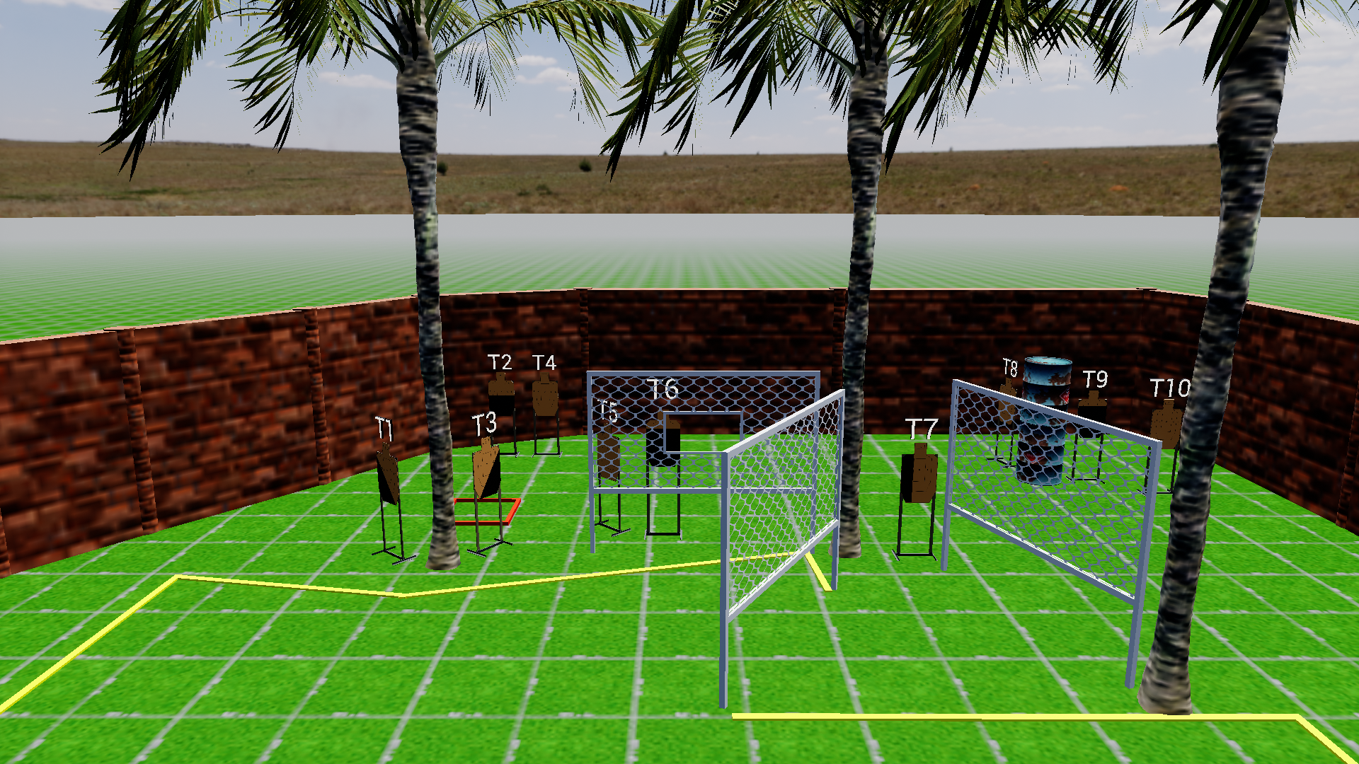
 | Stage 6 Wall Sits Course Designer: Jordan Rogers

